Slide 1
3 Tools of Prototyping - Case Study: Hospital Waiting Room
A comprehensive look at Wireframes, Mockups, and Interactive Prototypes

Slide 2
1. Wireframes
Wireframes are simple, low-fidelity layouts that focus on the structure of a design. In the case of the hospital waiting room, wireframes were used to design a basic layout of the kiosk screen.
- Structure includes navigation for appointments, restrooms, and nearby facilities.
- Provides an easy-to-read map and appointment status.

Slide 3
2. Mockups
Mockups add visual details like color, fonts, and icons. In this case, the kiosk design used calming colors and clear icons to help users easily access needed information.
- High-fidelity design focuses on aesthetics.
- Colors and branding were applied to enhance usability and appeal.

Slide 4
3. Interactive Prototypes
Interactive prototypes are clickable models that simulate the user experience. In the hospital case, the kiosk's interactive prototype allowed users to test features like checking appointments and navigating the map.
- Test user interaction before final product development.
- Gather feedback from hospital staff and patients on usability.

Slide 5
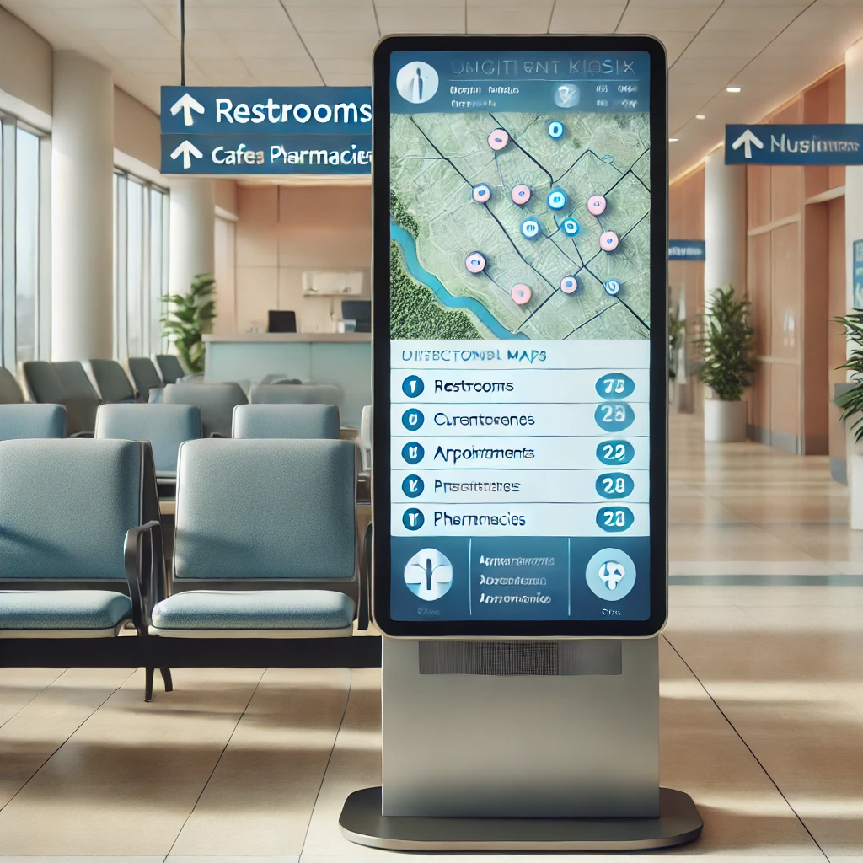
Hospital Waiting Room Kiosk - Prototype Example

